Slide 1
Solve Quora Question Pair Similarity Problem using Machine Learning Algorithms
PG - DASSD Sep-2021
Presented By:
Under the Guidance:
Yuvraj Takey
esec@cdac
Ilaveni Ranjith-(210950329009)
Komuravelli Priyanka-(210950329011)
Namindla Navanitha-(210950329016)

Slide 2
INTRODUCTION
Quora is a platform where people can ask their questions and get answers from different people, sometimes the questions asked may be asked in different format but the intent was the same
Ideally, what would happen is that once a question is asked, Quora would use some “technique” to find a subset of its existing question database such that this subset contains questions which are “similar” to or about the same topic as the new question being asked. Once this subset has been identified, Quora would employ a machine learning technique to then determine if a duplicate question exists in this selected subset.

Slide 3
PROBLEM STATEMENT:
Identify which questions on Quora are duplicate. This could be useful to instantly provide answers to questions that have already been answered. We are tasked with predicting whether a pair of questions are duplicates or not.

Slide 4
SOFTWARE & HARDWARE REQUIREMENTS :
Hardware Specification:
Processor – i3 or more
Hard Disk – 50 GB
Memory – Min 4GB RAM
Software Specification:
Operating System : Windows 7 or more
Language: Python
IDE : Jupyter Notebook

Slide 5
DATASET
A data set is a collection of data. In the case of tabular data, a data set corresponds to one or more database tables, where every column of a table represents a particular variable, and each row corresponds to a given record of the data set in question. The data set lists values for each of the variables, such as height and weight of an object, for each member of the data set. Data sets can also consist of a collection of documents or files.
We got this dataset from Kaggle Website which is best place to get predefined/developed datasets which are used in various machine learning problems

Slide 6
Reading the dataset from Kaggle:
To read the dataset we use Pandas Library in python which is used to read and analyse the dataset which are in CSV or
Excel Files.
Handling the Missing data:
If there is any missing data in the dataset we should handle them by filling them or dropping the missing values.
Pre-processing:
In this Step we will clean the data by using some python libraries like beautifulsoup, Stop words, for increasing the readability, In this step we will convert the Uppercase letters to Lower case and remove the HTML tags and all and helps in reducing the complexity in reading strings by converting strings into numerics.

Slide 7
FEATURE EXTRACTION:
Basic Features - Extracted some features before cleaning of data as below.
q1len = Length of q1
q2len = Length of q2
q1_n_words = Number of words in Question 1
q2_n_words = Number of words in Question 2
word_Common = (Number of common unique words in Question 1 and Question 2)
word_Total =(Total num of words in Question 1 + Total num of words in Question 2)
word_share = (word_common)/(word_Total)

Slide 8
Advanced Features:
Did some preprocessing of texts and extracted some other features. i am giving some definitions which are used below. Token- You get a token by splitting sentence by space , Stop_Word - stop words as per NLTK, Word -A token that is not a stop_word.
cwc_min = common_word_count / (min(len(q1_words), len(q2_words))
cwc_max = common_word_count / (max(len(q1_words), len(q2_words))
csc_min = common_stop_count / (min(len(q1_stops), len(q2_stops))
csc_max = common_stop_count / (max(len(q1_stops), len(q2_stops))
ctc_min = common_token_count / (min(len(q1_tokens), len(q2_tokens))
ctc_max = common_token_count / (max(len(q1_tokens), len(q2_tokens))
last_word_eq = Check if Last word of both questions is equal or not (int(q1_tokens[-1] == q2_tokens[-1]))
first_word_eq = Check if First word of both questions is equal or not (int(q1_tokens[0] == q2_tokens[0]) )
abs_len_diff = abs(len(q1_tokens) - len(q2_tokens))
mean_len = (len(q1_tokens) + len(q2_tokens))/2

Slide 9
Fuzzy Features:
fuzz_ratio = How much percentage these two strings are similar, measured with edit distance.
fuzz_partial_ratio = if two strings are of noticeably different lengths, we are getting the score of the best matching lowest length substring.
token_sort_ratio = sorting the tokens in string and then scoring fuzz_ratio.
longest_substr_ratio = len(longest common substring) / (min(len(q1_tokens), len(q2_tokens))
Feature Scaling:
It is a step of Data Pre Processing that is applied to independent variables or features of data.It basically helps to normalize All the data within a particular range, so that each and every data in same Range.
CountVectorizer:
Convert a collection of text documents to a matrix of token counts.
This implementation produces a sparse representation of the counts using scipy.sparse.csr_matrix.

Slide 10
Machine Learning Models
We Applied Some Machine Learning Classification Models to Solve the Quora Question Pair similarity Problem, They are:
Decision Tree
Random Forest Classifier
Logistic Regression Classifier
XGboost

Slide 11
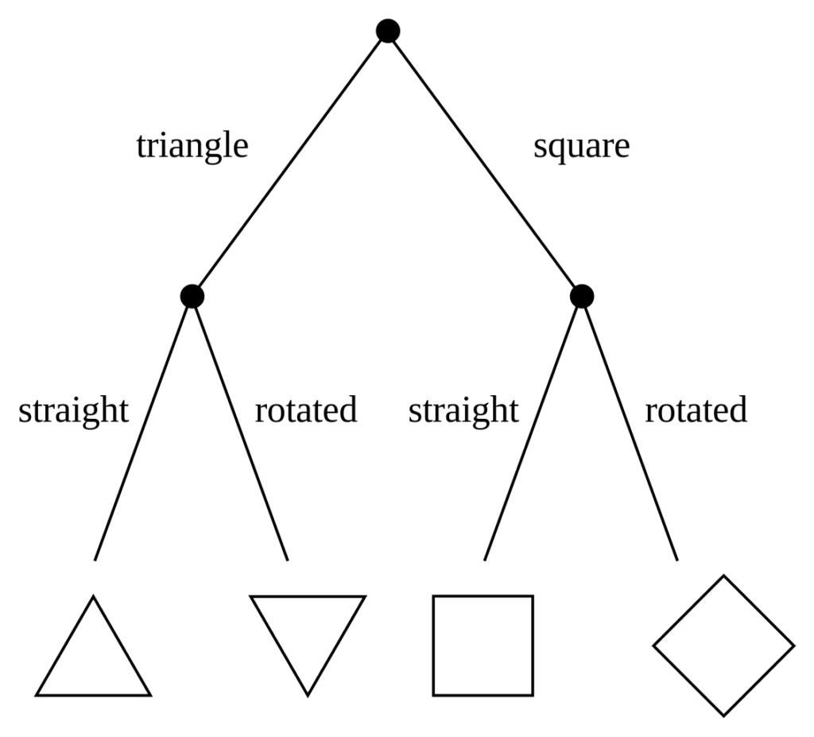
Decision Tree
It is process of choosing course of action from among alternatives to achieve a desired goal.
It is a graphical representation of possible solutions to a decision based on certain conditions.
it starts with a single root which then branches off into a number of solutions just like tree.
Advantages:
These are simple to understand and interpret.
these are very fast and efficient.
The data type of decision tree can handle any type of data whether it is numerical or categorical, or boolean.
Normalization is not required in the Decision Tree.
It can be used in Both Classification and Regression Models.

Slide 12

Random Forest Classifier
Random forest is a Supervised Machine Learning Algorithm that is used widely in Classification and Regression problems.
It builds decision trees on different samples and takes their majority vote for classification and average in case of regression.
Advantages:
It can be used in classification and regression problems.
It solves the problem of overfitting as output is based on majority voting or averaging.
It performs well even if the data contains null/missing values.
Each decision tree created is independent of the other thus it shows the property of parallelization.
It is highly stable as the average answers given by a large number of trees are taken.
We don’t have to segregate data into train and test as there will always be 30% of the data which is not seen by the decision tree made out of bootstrap.

Slide 13
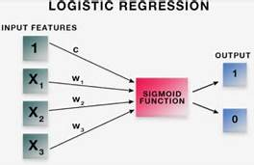
Logistic Regression Classifier
Logistic regression is a supervised learning classification algorithm used to predict the probability of a target variable.
Using Logistic Regression, you can predict and establish relationships between dependent and one or more independent variables.
Logistic Regression equations and models are generally used for predictive analytics for binary classification. You can also use them for multi-class classification
Advantages:
Logistic regression is easier to implement, interpret and very efficient to train.
Logistic Regression performs well when the dataset is linearly separable.

Slide 14
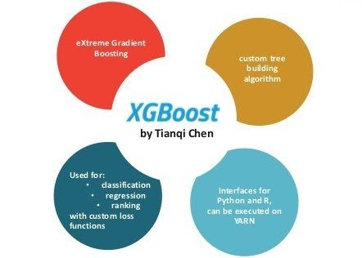
XGBOOST
XGBoost is an optimized distributed gradient boosting library designed to be highly efficient, flexible and portable. It implements machine learning algorithms under the Gradient Boosting framework. XGBoost provides a parallel tree boosting that solve many data science problems in a fast and accurate way.
Advantages:
It is Highly Flexible
It uses the power of parallel processing
It is faster than Gradient Boosting
It supports regularization.
It is designed to handle missing data with its in-build features.
The user can run a cross-validation after each iteration.
It Works well in small to medium dataset

Slide 15
Results
Models | Accuracy Score
Decision Tree | 79.5784
Random Forest | 79.5784
Logistic Regression | 72.323
XGBoost | 79.588

Slide 16
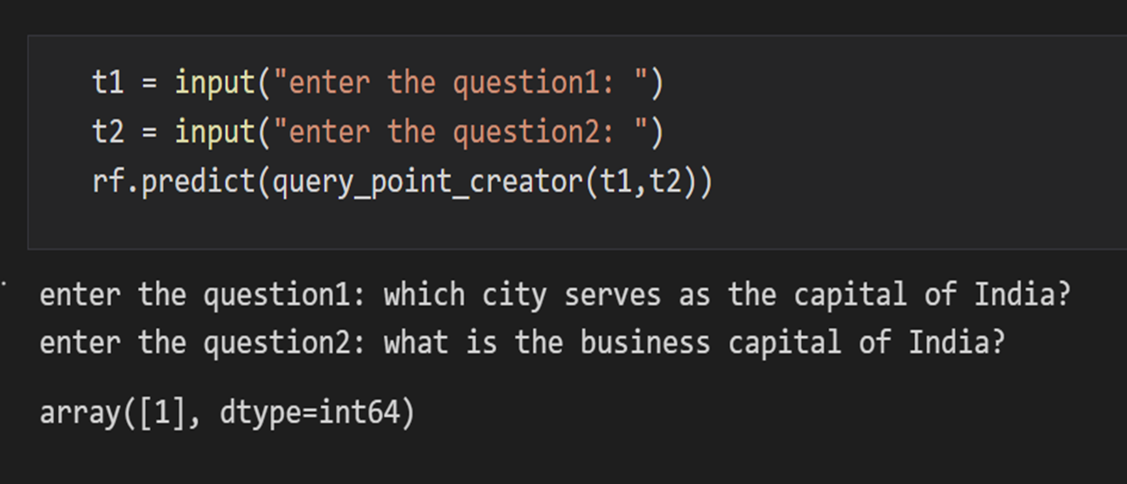

Slide 17
Conclusion
In this Project, The Quora Question Pair dataset is used to predict the similarity between the two questions for duplicity using Machine Learning Algorithms. before applying Machine Learning Models we done the Preprocessed the dataset and applied some models and we got the results as below mentioned.
By seeing the above table we can conclude that XGBoost classifier is the efficient among all other Classification Models with an accuracy of 79.588%, followed by Random Forest with 79.5784%, Decision Tree with 79.5784% and Logistic Regression Classifier with 72.323%.

Slide 18
References
Rishickesh Ramesh, R.P Ram Kumar, A. Shahina, Dr. A. Nayeemulla Khan “Identification of Duplication in Questions Posed on Knowledge Sharing Platform Quora using Machine Learning Techniques” IJITEE Journal Paper
AINAB IMTIAZ, MUHAMMAD UMER, MUHAMMAD AHMAD, SALEEM ULLAH, GYU SANG CHOI, ARIF MEHMOOD “Duplicate Questions Pair Detection Using Siamese MaLSTM”, IEEE Journal Paper
Logistic Regression classifier “https://www.geeksforgeeks.org/advantages-and-disadvantages-of-logistic-regression/”
Random Forest “https://www.analyticsvidhya.com/blog/2021/06/understanding-random-forest”
Decision Tree “https://www.slideshare.net/DakshGoyal3/decision-tree-69802132”
XG Boost Classifier “https://analyticsindiamag.com/xgboost-internal-working-to-make-decision-trees-and-deduce-predictions”
https://github.com/UdiBhaskar/Quora-Question-pair-similarity
https://www.kaggle.com/code/veerpalsingh/quora-question-pair-final
https://github.com/campusx-official/quora-question-pairs/blob/main/bow-with-preprocessing-and-advanced-features.ipynb

Slide 19
THANKYOU

